Slide 1
Talent Development
At HCL Java - Basic
Sangram Swain

Slide 2
Java – Introduction
JAVA was developed by Sun Microsystems Inc in 1991, later acquired by Oracle Corporation.
Java Terminology
javac is the primary java compiler included in java development kit (JDK).
Java Virtual Machine (JVM) executes the bytecode generated by compiler. This is called program run phase.
primary function of JVM is to execute the bytecode produced by compiler. Each operating system has different JVM, however the output they produce after execution of bytecode is same across all operating systems. That is why we call java as platform independent language.
Programmer Code
Java Bitecode
JVM Execute the bite code
javac

Slide 3
Java – Basics - Introduction
Java is a high-level programming language originally developed by Sun Microsystems.
Java runs on variety of platforms like Windows, Mac OS, UNIX etc.
Java is
Object Oriented: Everything in Java is an Object
Platform Independent: Once complied, it generates byte code which is platform independent. Byte code can run over any platform with the help of Java Virtual Machine (JVM)
Simple: Java is designed to be simple.
Secure: With its secure feature, it enables to develop virus-free and tamper-free systems.
Multithreaded: With Java's multithreaded feature it is possible to write programs that can do many tasks simultaneously. This design feature allows developers to construct smoothly running interactive applications.
Portable: java code that is written on one machine can run on another machine. The platform independent byte code can be carried to any platform for execution that makes java code portable.

Slide 4
JDK-JRE-JVM
JDK: Java Development Kit contains everything that will be required to develop and run any Java Application
JRE: Java Runtime Environment contains everything required to run any Java Application which is already complied. It does not contain library which is required to develop java application
JVM: Java Virtual Machine is a virtual machine which work over your operating system to provide proper environment for your compiled Java code. JVM only works with bytecode.

Slide 5
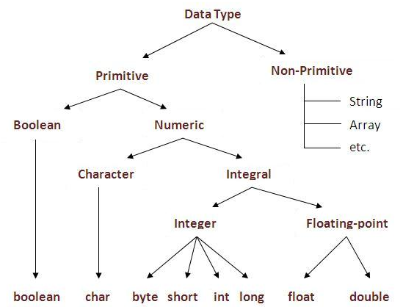
Data Type in Java

Slide 6
Primitive Types and Variables
Boolean, char, byte, short, int, long, float, double
These basic types are the only types that are not objects which means new operator can not be used to create primitive variables.
Declaring primitive variables
float initValue;
Int retVal, index;
Double gamma = 1.2
Boolean valueOK = false

Slide 7
Data Type in Java
Data Type | Default Size
boolean | 1 bit
char | 2 byte
byte | 1 byte
short | 2 byte
int | 4 byte
long | 8 byte
float | 4 byte
double | 8 byte

Slide 8
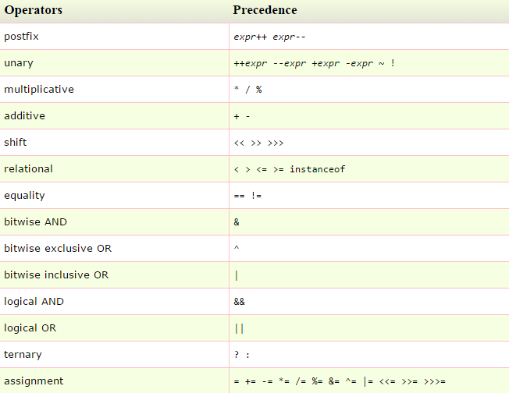
Java - Operator

Slide 9
Java – Assignment Operation
Expression | Meaning
x += y | x = x + y
x -= y | x = x - y
x *= y | x = x * y
x /= y | x = x / y

Slide 10
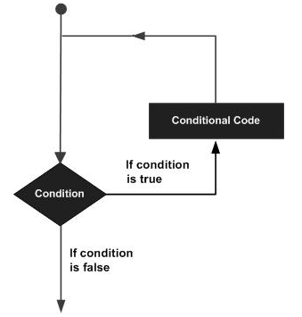
Java - Loop
A loop statement allows us to execute a statement or group of statements multiple times and following is the general form of a loop statement in most of the programming languages:

Slide 11
Java - Loop
Loop Type | Description
while | Repeats a statement or group of statements while a given condition is true. It tests the condition before executing the loop body
for | Execute a sequence of statements multiple times and abbreviates the code that manages the loop variable
do..while | Like a while statement, except that it tests the condition at the end of the loop body
if – else | Executed a sequence of code if the condition in if it true, else will go to the else block
Loop Control Statements
Break | Terminates the loop or switch statement and transfers execution to the statement immediately following the loop or switch.
Continue | Causes the loop to skip the remainder of its body and immediately retest its condition prior to reiterating.

Slide 12
Java – Sample Code – Loop Statement
While loop
public class whileClass {
public static void main(String[] args) {
// Looping using while statement
int whileCount = 0;
while (whileCount < 5 ){
System.out.println("Executing the while loop - "+whileCount);
whileCount++;
}
}
For Loop
public class forClass {
public static void main(String[] args) {
// Looping using for statement
int forCount = 0;
for (forCount = 0; forCount <5; forCount++){
System.out.println("Executing the for loop - "+ forCount);
}
}

Slide 13
Java – Sample Code – Loop Statement
do-while statement
public class LoopClass {
public static void main(String[] args) {
// Looping using do-while statement
int doCount = 0;
do {
System.out.println("Executing do-while loop - " + doCount);
doCount++;
} while (doCount < 5);
}
}
if-else statement:
public class LoopClass {
public static void main(String[] args) {
// Looping using if-else statement
int ifCount = 0;
if (ifCount ==0){
System.out.println("if block executed");
}
else{
System.out.println("Else Block Executed");
}
}
}

Slide 14
Java – switch – case - break
switch: This option allows to take different option depending on the variable supplied to it.
Syntax
switch (n):{
case 1:
//Execute Block 1
break;
case 2:
//Execute Block 1
break;
default:
//if all previous tests fails, then default section will be //executed,
break;
}

Slide 15
Java – break and continue
break: A break statement causes an EXIT from the inner most loop containing while, do, for or switch statement
continue: continue can only be used with while, do and for. The continue statement causes the innermost loop to start the next iteration immediately.

Slide 16
Java – Methods and Classes
Object: is a bundle of data and its behavior. Objects have two characteristics: They have states and behaviors.
Example: Object – House
State – Address, Color, Area
Behavior – Open Door, Close Door
Class: A class can be defined as a template/blueprint that describes the behavior/state that the object of its type support.
Object
Instance of
Class

Slide 17
Java – Methods and Classes
Classes are object definitions.
OOP – Object Oriented Programing
Encapsulation: Objects hide their functions (methods) and data (instance variables)
Inheritance: Each subclass inherits all variables of its superclass
Polymorphism: Interface same despite different data types. Same function will behave differently depending on the parameter supplied to it
Sample class
class Fruit{ //class
int grams; // class variable declaration
int cals_per_gram; // class variable declaration
int total_calories(){ //class methods
return (grams * cals_per_gram);
}
}

Slide 18
Java – Methods
A method is a named sequence of code that can be invoked by other Java code.
A method takes some parameters, performs some computation and may/ may not return a value or object.
Method signature specifies :
the name of the method
The type and name of each parameter
The type of value (or object) returned by the method
Various method modifier
Modifiers type name (parameter list) [throws exceptions]
public float convertCelsius (float tempFar) {}
public boolean setUserInfo (int i, int j, String name) throws IndexOutOfBoundsException{}

Slide 19
Java – Using Objects
A method is a named sequence of code that can be invoked by other Java code.
A method takes some parameters, performs some computation and may/ may not return a value or object.
Method signature specifies :
the name of the method
The type and name of each parameter
The type of value (or object) returned by the method
Various method modifier
Modifiers type name (parameter list) [throws exceptions]
public float convertCelsius (float tempFar) {}
public boolean setUserInfo (int i, int j, String name) throws IndexOutOfBoundsException{}

Slide 20
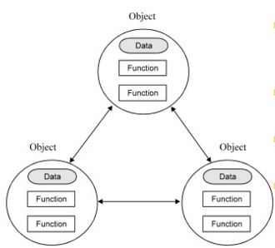
OOP: model, map, reuse, extend
Model the real world problem to the user’s perceive
Use similar metaphor in computational env.
Construct reusable component
Create new components from existing ones

Slide 21
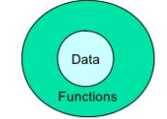
OOP - Encapsulation
It associates the code and data it manipulate into a single unit and keep them safe from external interface and misuse

Slide 22
OOP – Data Abstraction
The technique of creating new data types that are well suited to an application.
It allows the creation of user defined data types having the properties of built data types and a set of permitted operators
Abstract Data Type:
A Structure that contains both data and the actions to be performed on the data
Class is an implementation of abstract data type

Slide 23
Class Example
class Account{
//data
private String accountName;
private double accountBalance;
//methods
public withdraw();
public deposite();
public dtermineBalance();
}

Slide 24
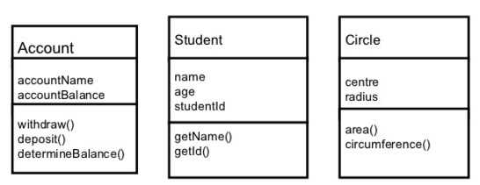
Class
Class is a set of attributes and operations that are performed on the attributes.

Slide 25
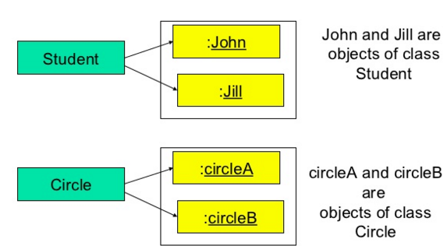
Object
An Object Oriented system is a collection of interacting Objects
Object is an instance of a class.
Classes and Objects

Slide 26
Class and Object
Class
A class represents a template for several objects that are having common properties.
A class defines all properties common to the object – attributes and methods.
A class is sometimes called the Object’s type.
Object
Object have state and classed does not have
John is an Object (instance) of student class having attributes name = “John”, age = 20, studentId = 1236
CircleA is an object (instance) of class Circle having attribute centre = (0, 0) and radious = 10

Slide 27
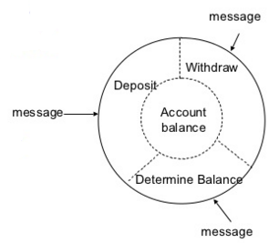
Encapsulation
All information (attributes and methods) in an object oriented system are stored within the object/ class.
Information can be manipulated through operations performed on the object/ class – interface to the class. Implementation is hidden from the user.
Object supports Information Hiding – Some attributes and methods can be hidden from the user.
class Account{
//data
private String accountName;
private double accountBalance;
//methods
public withdraw();
public deposite();
public dtermineBalance();
}

Slide 28
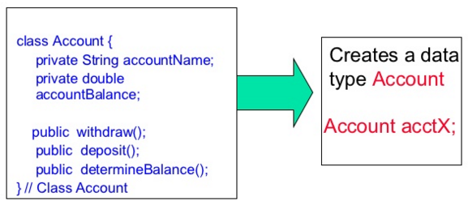
Data Abstraction
The technique of creating new data types that are well suited to an application.
It allows to create user defined data types having the properties of build in data types and more.

Slide 29
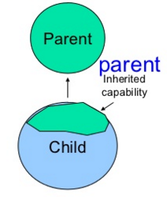
Inheritance
New data types (classed) can be defined as extension to previously defined types.
Parent Class (Super Class) – Child Class (Sub Class)
Sub class inherits properties from the Parent Class

Slide 30
Inheritance - Example
Define Person to be class
A Person has attributes such as age, height, gender
Assign value to attributes when describing objects
Define Student to be a subclass of Person
A Student has all attributes of Person, plus attributes of his/ her own (roll_no, course_enrolled)
A Student inherits all attributes from Person
Define Lecturer to be subclass of Person
Lecturer has all attributes of Person, plus attributes his/ her own (staff_id, subjectID1, subjectID2)

Slide 31
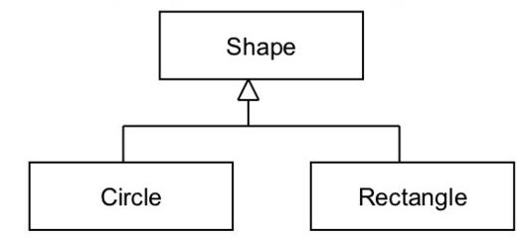
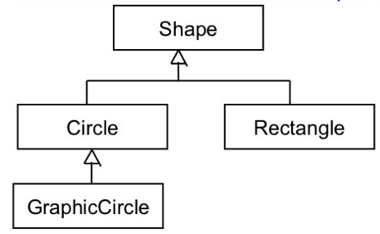
Inheritance - Example
Circle class can be a subclass of (inherited from) parent class – Shape
Inheritance can also have multiple level.

Slide 32
Use of Inheritance
If multiple classes have common attributes/ methods, these methods can be moved to a common classes – parent class
This allows reuse since the implementation is not repeated

Slide 33
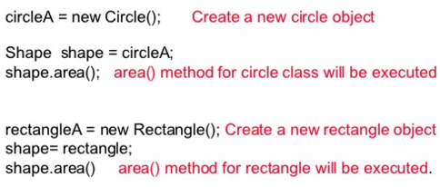
Polymorphism
It means many forms
Allows a single object, method, operator associated with different meaning depending on the type of data passed to it.
An object of type Circle or Rectangle can be assigned to Shape object. The behavior of the object will depend on the object passed.

Slide 34
Polymorphism – method overloading
Multiple methods can be defined with the same name, different input arguments
Method 1 – initialize (int a)
Method2 – initialize (int a, int b)
Appropriate methods will be called based on the input argument
initialize (2) – Method 1 will be called
initialize (2, 4) – Method 2 will be called.

Slide 35
Java - Constructor
Constructors are methods which are used to initialize objects.
Constructor methods have the same name as that of the class.
They are called/ invoked when and object of the class is created
They can’t be called explicitly.
public class ConstructorExample {
//Constructor method
ConstructorExample(){
System.out.println("Constructor method called");
}
public static void main (String[] args){
//Creating objects
ConstructorExample conEx = new ConstructorExample();
}
}

Slide 36
Constructor Overloading
Like Java methods, constructor can be overloaded.
We can create as many number of constructors in a class.
Number of constructors depends on information about the attributes of an object we have while creating the objects.
Types of Constructor
Default: no parameter
Parameterized:
Difference between Constructor and Methods
Java Constructor | Java Methods
Constructor is used to initialize the state of an object. | Method is used to expose behaviour of an object.
Constructor must not have return type. | Method can have return type.
Constructor is invoked implicitly. | Method is invoked explicitly.
he java compiler provides a default constructor if you don't have any constructor | Method is not provided by compiler in any case
Constructor name must be same as the class name. | Method name may or may not be same as class name.

Slide 37
Constructor Overloading Example
public class Language {
String name;
Language(){
System.out.println("Constructor method called");
}
Language(String str){
name = str;
}
public static void main(String[] args){
Language cpp = new Language();
Language java = new Language("Java");
cpp.setName("C++");
java.getName();
cpp.getName();
}
void setName(String t){
name = t;
}
void getName(){
System.out.println("Language name = "+ name);
}
}

Slide 38

Java – Array
An array is a list of similar things.
An array has a fixed
name
type
length
These must be declared when the array is created
Array size can not be changed during the execution of the code.
myArray has room for 8 elements
The elements are accessed by their index
In Java, array indices start at 0

Slide 39
Java – Declaring Array
int myArray[]
Declaring myArray to be an array of integers
myArray[] = new int[8];
Sets up 8 integer sized spaces in memory, labelled myArray[0] to myArray[7]
Assigning values
Refer to the array elements by index to store values in them
myArray[0] = 10;
myArray[4] = 14
Can create and initialize in one step
int myArray [] = {1, 2, 3, 4, 5, 6, 7, 8};
We can create array of type integer, float, double, characters

Slide 40
Declaring Array
Like any other variable, array must be declared and created before they can be used. Creation of array involves 3 steps
Declare the array
Create storage area in memory
Put values into the arrays
Declaration of arrays
Form 1: Type arrayName[]
Form 2: Type [] arrayName
Example
int students[]
Int [] students
Note: we don’t specify the size of array in the declaration

Slide 41
Creation of Arrays
After declaring the array, we need to allocate memory for storing array items
In Java, this is created using the “new” operator.
ArrayName = new type[size];
Example
students = new int [7];
Once array is created, they need to be initialized with value
students[0] = 50;
students[1] = 60;
Java created arrays starting with index 0 and ends with value 1 less than the size
Length method gives the size of array – student.length will return 7

Slide 42
Array - Example
public class arrayExample {
public static void main(String[] args) {
int[] students; // Declaration
students = new int [7]; // Creation
//This can be done directly too without using the new operator
// int[] students = {10, 20, 30, 40, 50, 60, 70};
System.out.println("Length of array = "+ students.length); // Will print 7
// Array element allocation
for (int i = 0; i < students.length; i++){
students[i] = i * 2;
}
//Element traversal and printing.
for (int i = 0; i < students.length; i++){
System.out.println(students[i]);
}
}
}

Slide 43
String
String manipulation is the most common operation performed in Java. Easiest way to represent a String (a sequence of character) is by using an array of characters.
char place[] = new char[4];
place [0] = ‘J’;
place [1] = ‘A’;
place [2] = ‘V’;
place [3] = ‘A’;
Character array are too primitive and does not support lots of String functions such as copying, searching pattern etc
Java supports String as one of the fundamental data type only.

Slide 44
String Class
Declaration and Creation
String stringName;
stringName = new String (“Java”);
Example
String city;
city = new String (HCL);
Length of the string can be accessed by using the length() method
int len = city.length();

Slide 45
String class - constructor
public String () – creates an empty string
public String (String value) – creates a new string copying the specified value

Slide 46
String - operation
Method | Funtionality
length() | Returns the length of the string
charAt(int index) | Returns the character at the index
replace (char oldChar, char newChar) | Returns the new string with the oldChar being replaced by newChar
trim() | Trims the leading and trailing white spaces
toLowerCase () | Converts and returns lower case
toUpplerCase () | Converts and returns upper case

Slide 47
String Example
public class StringDemo {
public static void main(String[] args) {
String s = new String("Have a nice day");
// Length method
System.out.println("length =" + s.length());
//Modifying the string
System.out.println("Modifed string = "+ s.replace('n', 'N'));
//To upper case
System.out.println("Uppercase ->" + s.toUpperCase());
//To lower case
System.out.println("Lowercase ->" + s.toLowerCase());
}
}

Slide 48
Java – Access Modifiers
Access modifiers set access levels of classes, variables, methods and constructors.
Types of Access Modifier
Public: Visible globally
Private: Visible to class only
Protected: Visible to the package and subclasses only.

Slide 49
Access Modifier - Public
A class, method, constructor, interface etc declared public can be accessed from any other class. Therefore fields, methods, blocks declared inside a public class can be accessed from any class.
Because of class inheritance, all public methods and variables of a class are inherited by its subclasses
Example:
public static void main (String[] args) – main method of an application has to be public.

Slide 50
Access Modifier - Private
Methods, Variables that are declared private can only be accessed within the declared class itself.
Private access modifier is the most restrictive access level. Class and interfaces cannot be private.
Using the private modifier is the main way that an object encapsulates itself and hide data from the outside world.

Slide 51
Access Modifier – Private - Example
public class Logger {
private String format;
public String getFormat() {
return this.format;
}
public void setFormat(String format) {
this.format = format;
}
}
format variable of the Logger class is private, so there's no way for other classes to retrieve or set its value directly
So to make this variable available to the outside world, we defined two public methods: getFormat(), which returns the value of format, andsetFormat(String), which sets its value.

Slide 52
Access Modifier - Protected
Variables, methods which are declared protected in a superclass can be accessed only by the subclasses in other package or any class within the package of the protected members' class
The protected access modifier cannot be applied to class and interfaces.
Methods, fields can be declared protected, however methods and fields in a interface cannot be declared protected. Protected access gives the subclass a chance to use the helper method or variable, while preventing a nonrelated class from trying to use it

Slide 53
Access Modifier – Protected - Example
class AudioPlayer {
protected boolean openSpeaker(Speaker sp) {
// implementation details
}
}
class StreamingAudioPlayer extends AudioPlayer{
boolean openSpeaker(Speaker sp) {
// implementation details
}
}
The above parent class uses protected access control, to allow its child class override openSpeaker() method
Here, if we define openSpeaker() method as private, then it would not be accessible from any other class other than AudioPlayer
If we define it as public, then it would become accessible to all the outside world.
But our intension is to expose this method to its subclass only, thats why we used protected modifier

Slide 54
Access Modifier – On a Nut Shell
Private: Visible to the class only.
Public: Visible to the world.
Protected: Visible to the package and subclasses.

Slide 55
Access Control and Inheritance
Methods declared public in a superclass also must be public in all subclasses
Methods declared protected in a superclass must either be protected or public in subclasses; they cannot be private.
Methods declared without access control (no modifier was used) can be declared private in subclasses.
Methods declared private are not inherited at all, so there is no rule for them

Slide 56
Java – Exception Handling
An Exception can be anything which interrupts the normal flow of the program. When an exception occurs program processing gets terminated and doesn’t continue further. In such cases, system generates an error message.
Exception can occur at runtime (known as runtime exceptions) as well as at compile-time (known Compile-time exceptions).
There can be several reasons for an exception. For example, following situations can cause an exception – Opening a non-existing file, Network connection problem, Operands being manipulated are out of prescribed ranges, class file missing which was supposed to be loaded and so on.

Slide 57
Java – Exception Handling
Difference between Error and Exception
Errors indicate serious problems and abnormal conditions that most applications should not try to handle. Error defines problems that are not expected to be caught under normal circumstances by our program. For example memory error, hardware error, JVM error etc.
Exceptions are conditions within the code. A developer can handle such conditions and take necessary corrective actions. Few examples –
DivideByZero exception
NullPointerException
ArithmeticException
ArrayIndexOutOfBoundsException

Slide 58
Java – Exception Handling
Advantage of Exception Handling
Exception handling allows us to control the normal flow of the program by using exception handling in program.
It throws an exception whenever a calling method encounters an error providing that the calling method takes care of that error.
It also gives us the scope of organizing and differentiating between different error types using a separate block of codes. This is done with the help of try-catch blocks
Why to handle exceptions?
If an exception is raised, which has not been handled by programmer then program execution can get terminated and system prints a non user friendly error message.

Slide 59
Java – Exception Handling
Types of Exception
Checked exceptions: All exceptions other than Runtime Exceptions are known as Checked exceptions as the compiler checks them during compilation to see whether the programmer has handled them or not. If these exceptions are not handled/declared in the program, it will give compilation error. Examples are
ClassNotFoundException
IllegalAccessException
NoSuchFieldException
EOFException etc.
Unchecked exceptions: Runtime Exceptions are also known as Unchecked Exceptions as the compiler do not check whether the programmer has handled them or not but it’s the duty of the programmer to handle these exceptions and provide a safe exit. These exceptions need not be included in any method’s throws list because compiler does not check to see if a method handles or throws these exceptions.
ArithmeticException
ArrayIndexOutOfBoundsException
NullPointerException
NegativeArraySizeException etc.

Slide 60
Exceptions Handling – Using throws keyword
import java.io.*;
class Example {
public static void main(String args[]) throws IOException
{
FileInputStream fis = null;
fis = new FileInputStream("B:/myfile.txt");
int k;
while(( k = fis.read() ) != -1)
{
System.out.print((char)k);
}
fis.close();
}
}
File Content Will be displayed.

Slide 61
Exceptions Handling – Using try -catch
import java.io.*;
class Example {
public static void main(String args[])
{
FileInputStream fis = null;
try{
fis = new FileInputStream("B:/myfile.txt");
}catch(FileNotFoundException fnfe){
System.out.println("The specified file is not " +
"present at the given path");
}
int k;
try{
while(( k = fis.read() ) != -1)
{
System.out.print((char)k);
}
fis.close();
}catch(IOException ioe){
System.out.println("I/O error occurred: "+ioe);
}
}
}
This code will run fine.

